Slide 1
The Future of Genomics
Fernando Flores, CG(ASCP)^{CM}
Genetics Implementation Lead

Slide 2
The Path to Genomics
Where we began
  Two Labs, One Goal
Where we are now
  SoftGenomics
Where we are going
  SoftGenomics Extensions

Slide 3
Where we began – Two Labs, One Goal
Cytogenetics Labs
  Culture Processing
  Slide Processing
Molecular Labs
  Product Tracking
  NGS

Slide 4
Where we are now - SoftGenomics
Common Test Setup available from SoftGenomics
  Chromosome Analysis
  FISH
  Microarrays
  NGS (Next Generation Sequencing)
    Panels
    WES (Whole Exome Sequencing)
    WGS (Whole Genome Sequencing)
  Sanger Sequencing
  PCR
  MLPA
Ability to see tests from all technologies from one entry:
  Genomics (including Cytogenetics and Molecular),
  Flow Cytometry,
  Pathology
  HLA
  Biochemistry
  Microbiology
Notes:
The line between technologies in Cytogenetics and in Molecular labs have been blurring over the last few years. Molecular labs are performing FISH testing which traditionally was in Cytogenetic labs and Cytogenetics labs are performing testing based on molecular technologies like microarrays and even NGS (Next Generation Sequencing).
merging the AMA (American Medical Association) boards for Molecular and Cytogenetics to reflect this shift in the profession. Genetics professionals who interpret and sign out cytogenetic and molecular cases are required to take and pass these boards.

Slide 5
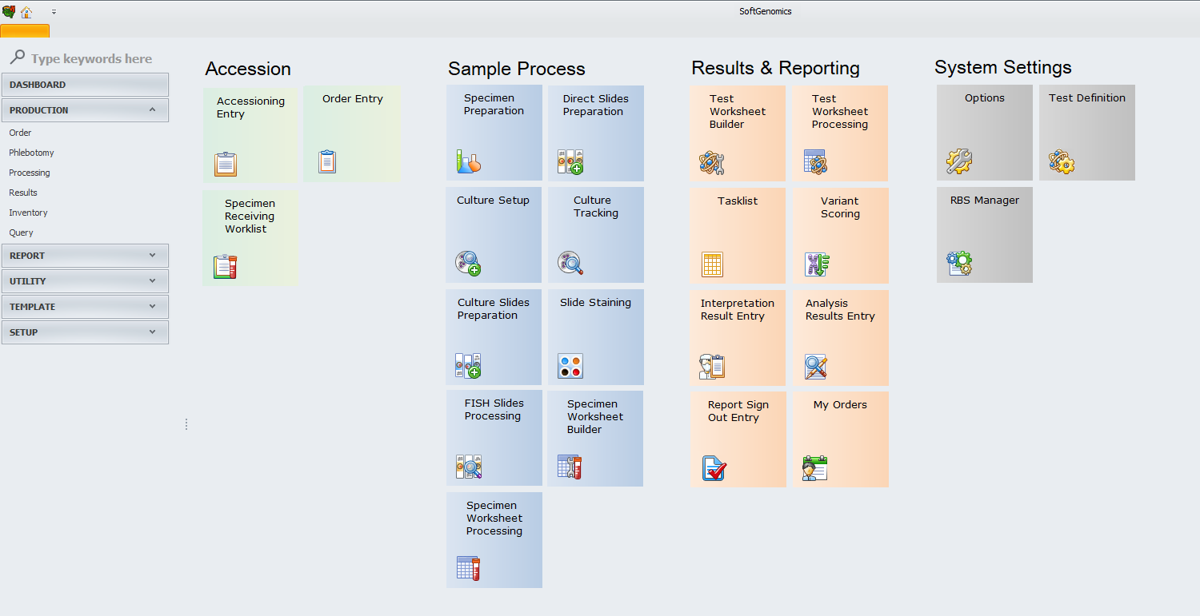
SoftGenomics - Overview
Departments may be assigned to genomics technology to have the ability to process both cytogenetics and molecular tests
Test can be defined as chromosome analysis, FISH analysis, array tests and single tests, while assigned to the same genomics technology

Slide 6
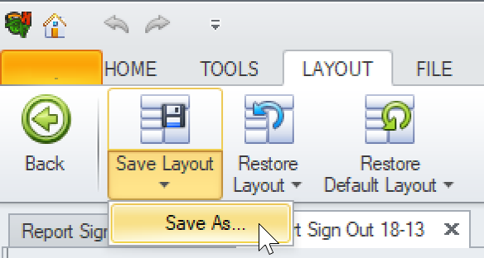
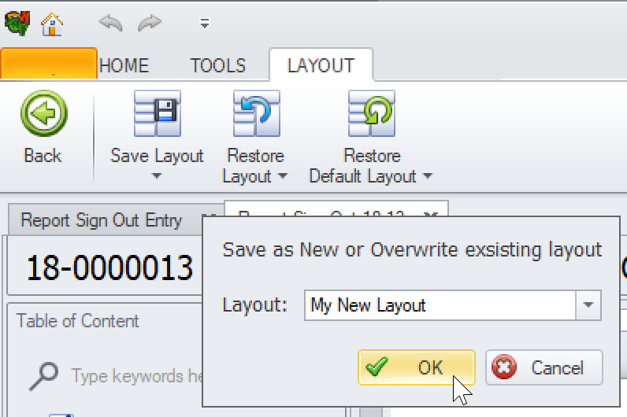
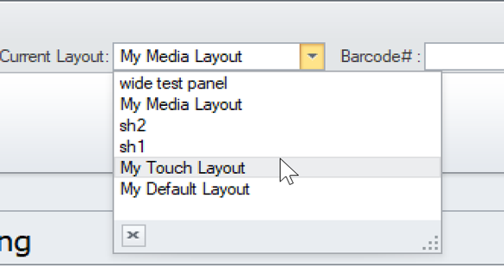
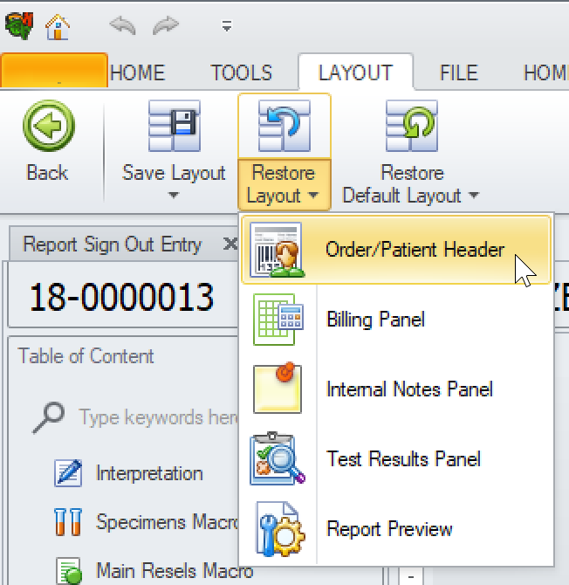
SoftGenomics - Named Layouts
Store screen layouts with a predefined ID, allowing the quick change of the layout
Rules to select Named Layout automatically or based on Interpretation Templates.
Restore the entire layout or select specific part of the layout to restore to a previous version or default
Tools to export/import whole layouts

Slide 7
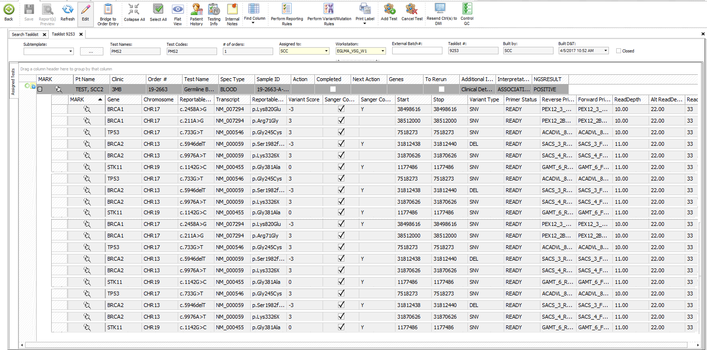
SoftGenomics - Tasklists
Dedicated Tasklist to handle multiple NGS results
Improved system performance for handling large amount of data

Slide 8
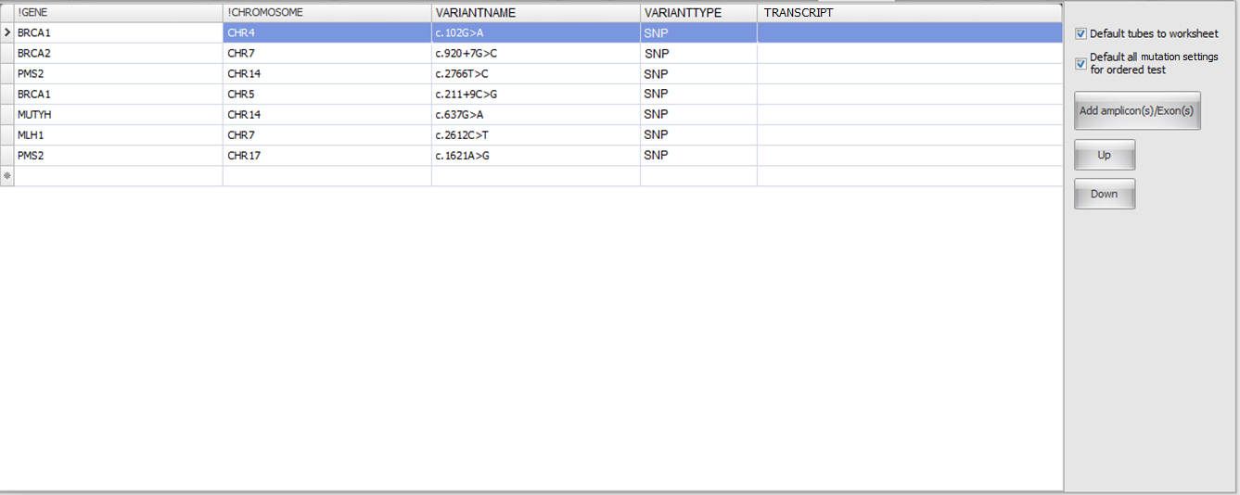
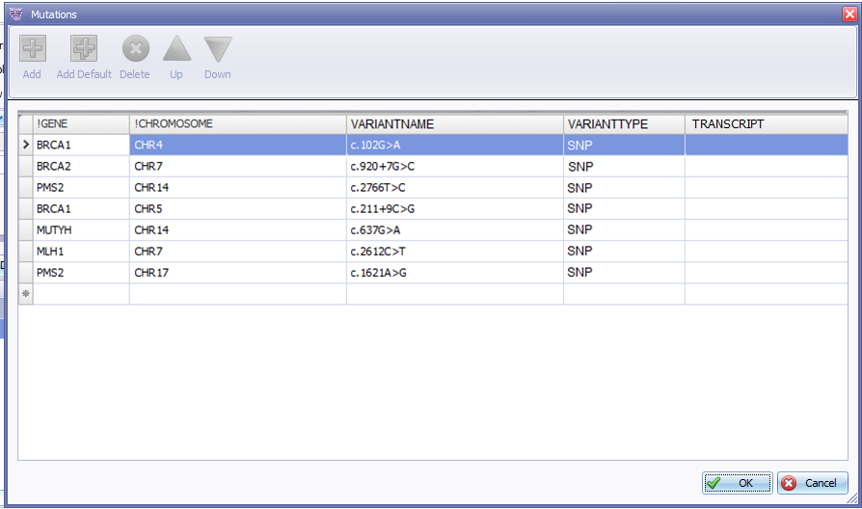
SoftGenomics - Mutations
Ability to order mutations for array tests
Test Definition allows rules that streamline the ordering of mutations depending on indication

Slide 9
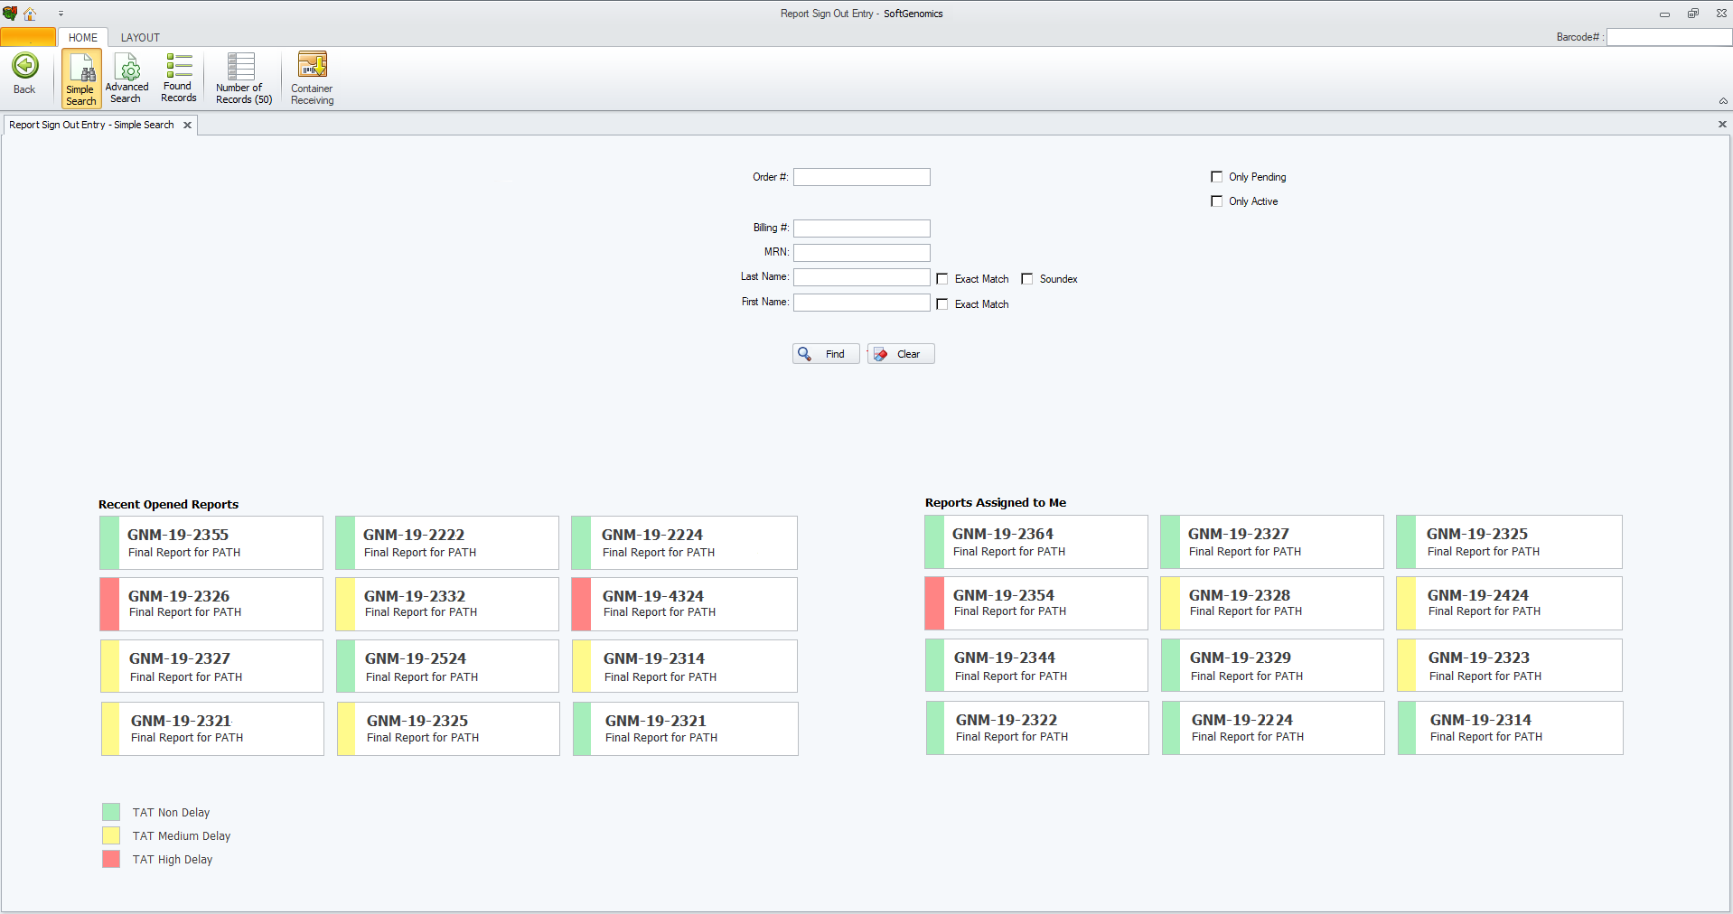
SoftGenomics - Resulting
Enhanced Sign Out Entry
  TAT indicators
  Report descriptions
  Ability to see tests from various technologies

Slide 10
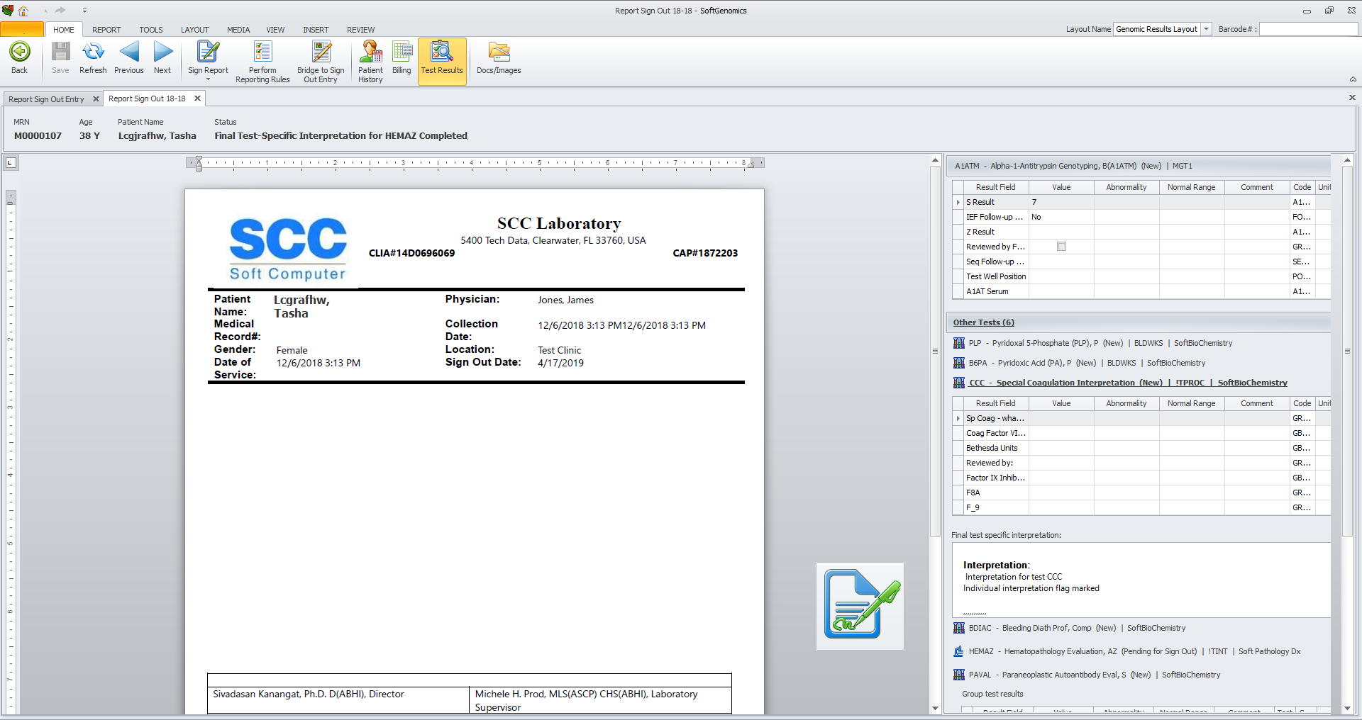
SoftGenomics - Reporting
Reporting entry for working in Page of Paper Mode
Many functions available in modeless panels
Panels can be docked anywhere or even on other monitors

Slide 11
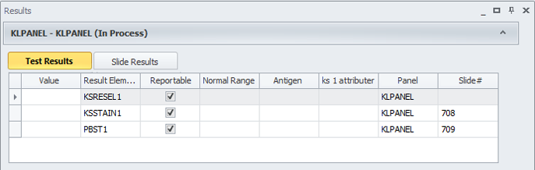
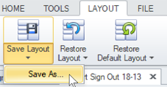
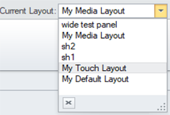


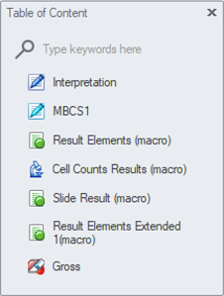
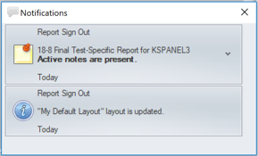

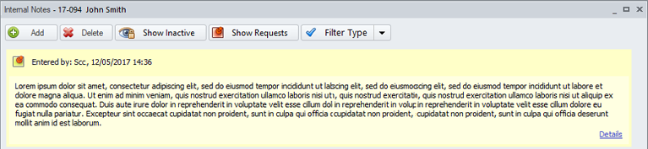
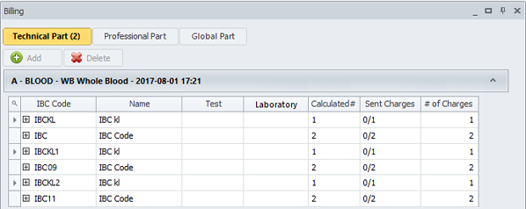
SoftGenomics - Reporting
Table of Contents
Patient Headers
Test Results
Notification Panel
Floating Action button
Billing Panel
Internal Notes
Named Layout Tools
And many more!

Slide 12
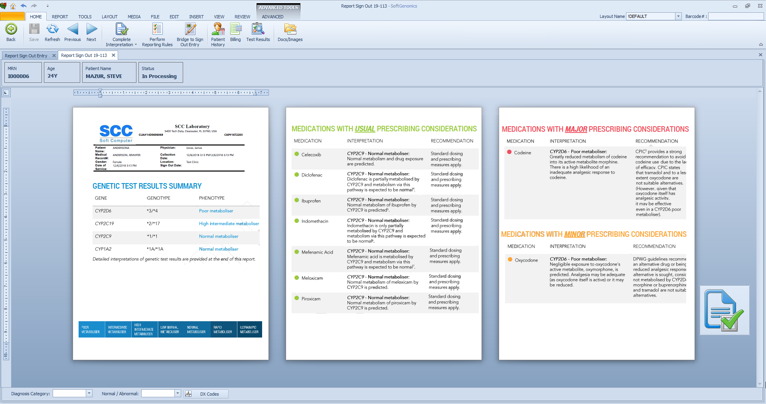
SoftGenomics - Pharmacogenetics
Ability to order medications for pharmacogenetics array tests
Rules to determine medication responses depending on found mutations
Allows the ordering of array tests with specific mutations based on the pharmacogenetics array test that was ordered

Slide 13
Where we are going - SoftGenomics Extensions
Additional functionality for Genomics Labs will be available in following optional modules:
  SoftTrack for Mobile Processing
  NGS Console for Processing NGS Pipelines
  Genomic Data Portal

Slide 14
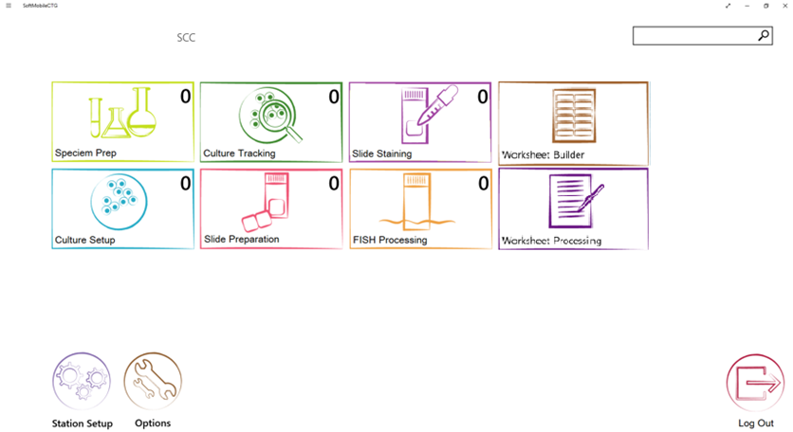
SoftGenomics – Mobile Processing
Mobile Processing of SoftGenomics materials via SoftTrack module
Processing of samples, cultures, slides and transfer them between departments
Ability to put cultures on worksheet/plate

Slide 15
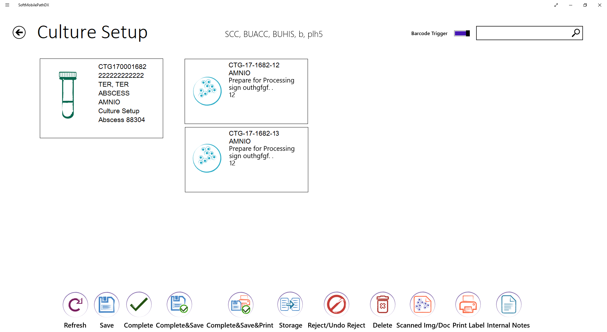
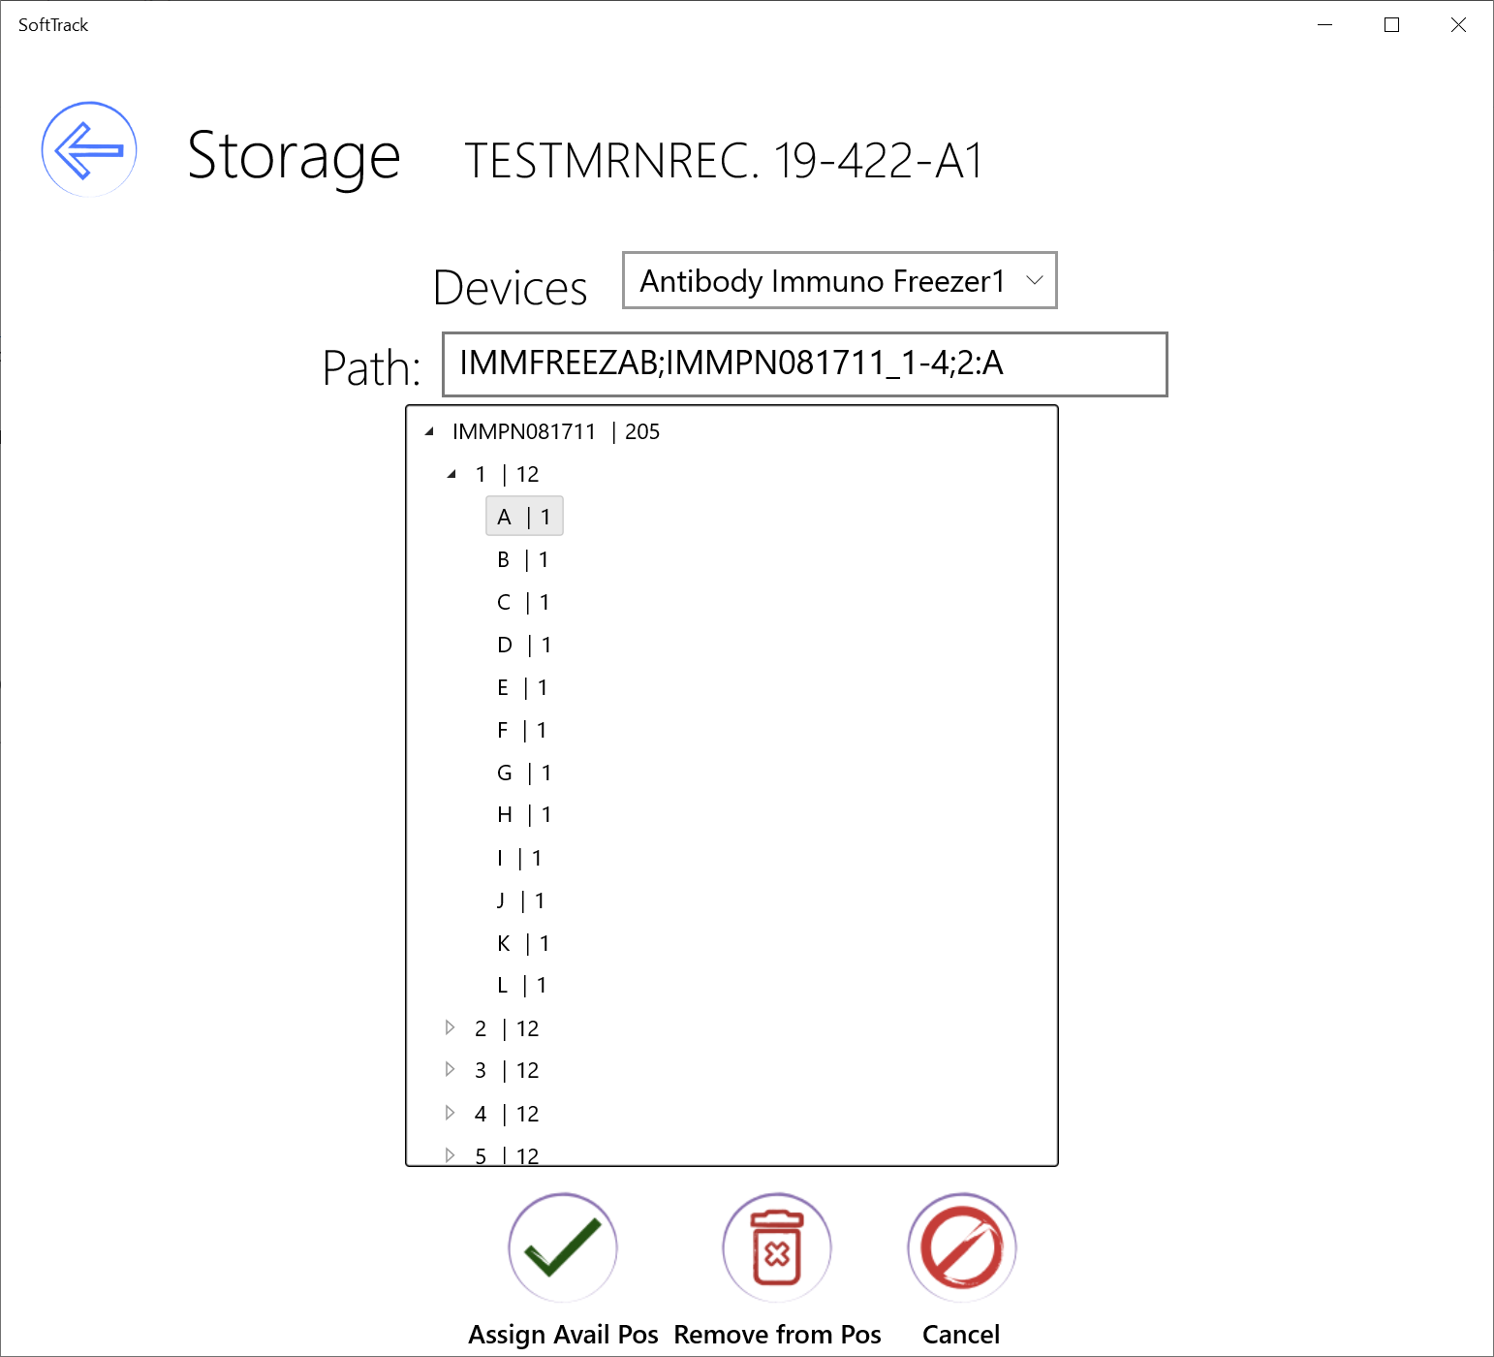
SoftGenomics – Mobile Processing
The user can perform specimen and product activities including DNA extraction, aliquoting and storage assignment

Slide 16
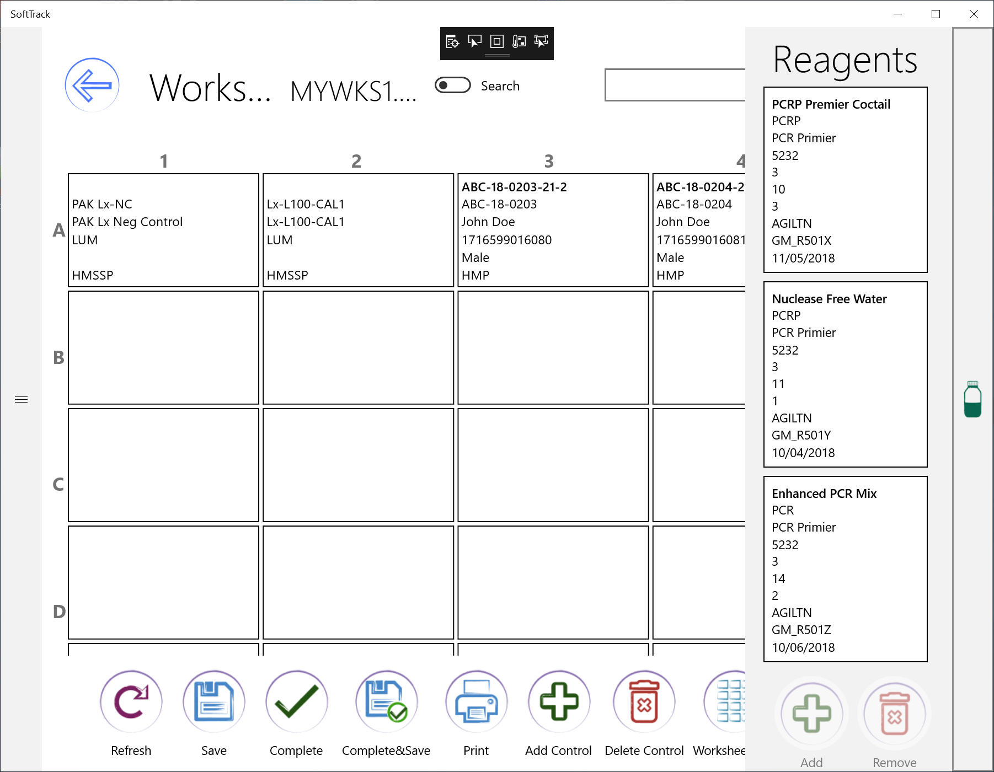
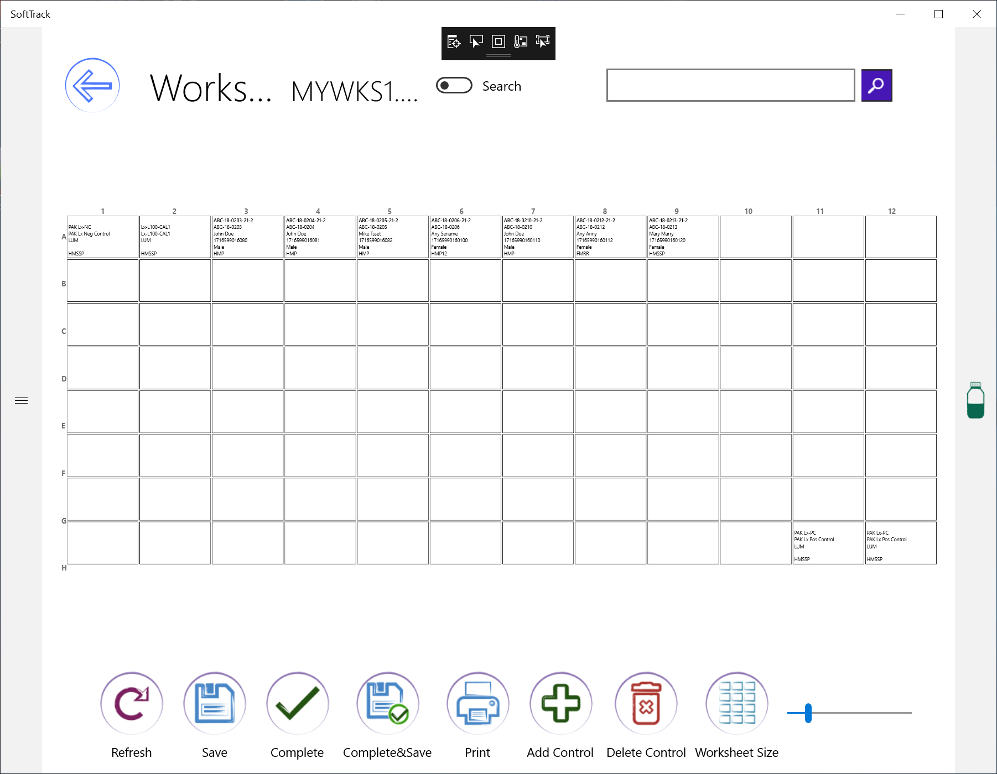
SoftGenomics – Mobile Processing
User can build plate map, adding samples, controls and reagents.
During execution of processing steps on the plate, user can add reagents that are required for particular step
Zoom functionality is available to make navigation easier on smaller screens

Slide 17
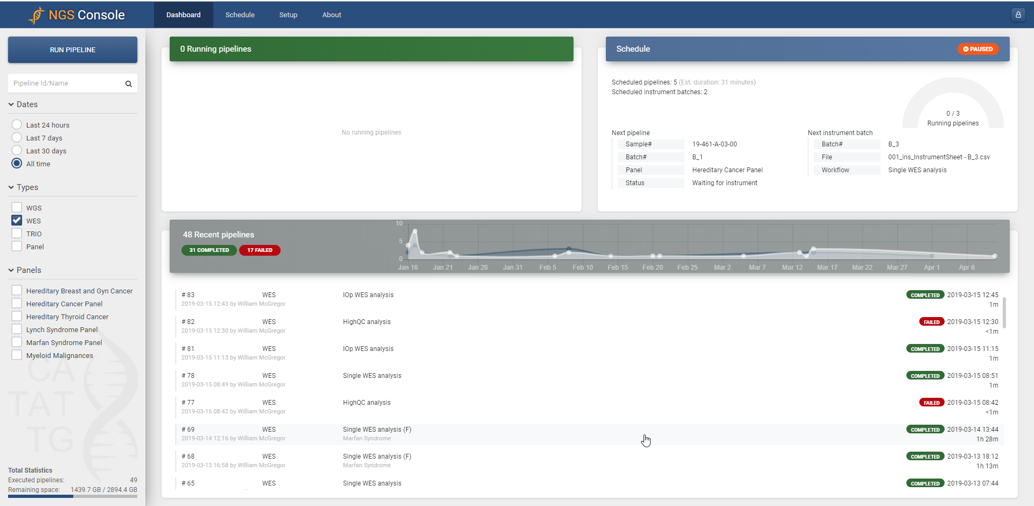
NGS Console
NGS console is optional module with SoftGeneomics to monitor processing NGS files through NGS Pipelines
NGS Files are processed for mutations/genes indicated for Genomics Tests
NGS Files are processed according to NGS pipelines assigned to actions in SoftGenomics Setup

Slide 18
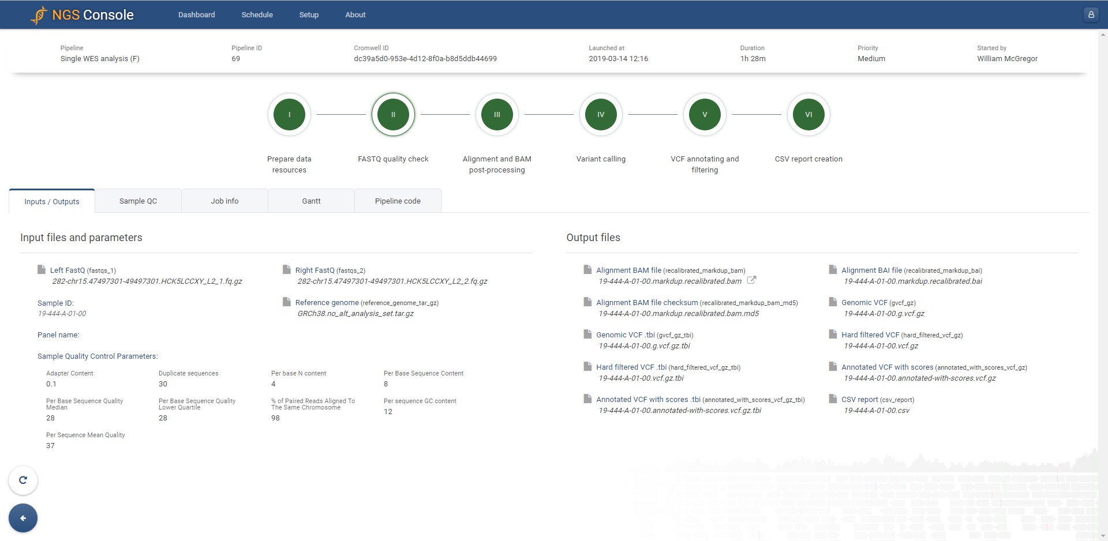
NGS Console – FASTQ Quality Check

Slide 19
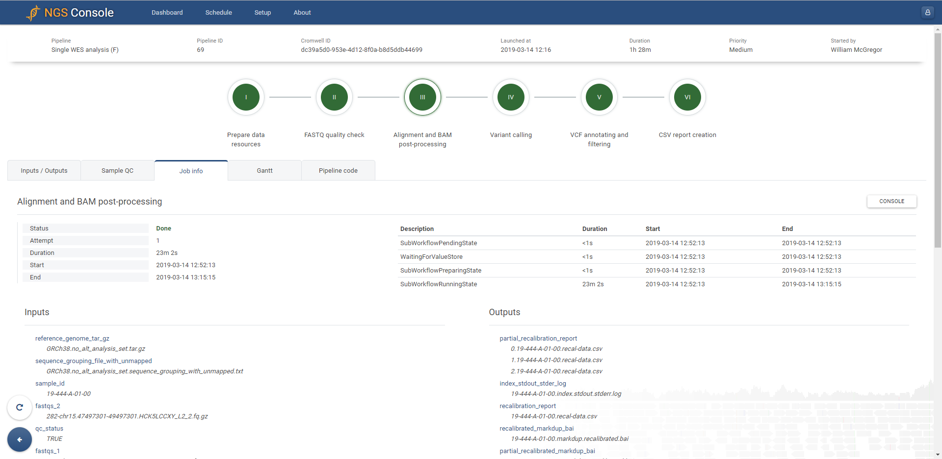
NGS Console – Alignment & BAM post-process
Pipelines use the following public databases:
  gnomAD
  ExAC
  1000 Genomes
  ESC6500
  MITOMAP
  ClinVar
  Human Phenotype Ontology
  dbSNP
  SnpEff
  GERP
  SIFT
  PhastCons

Slide 20
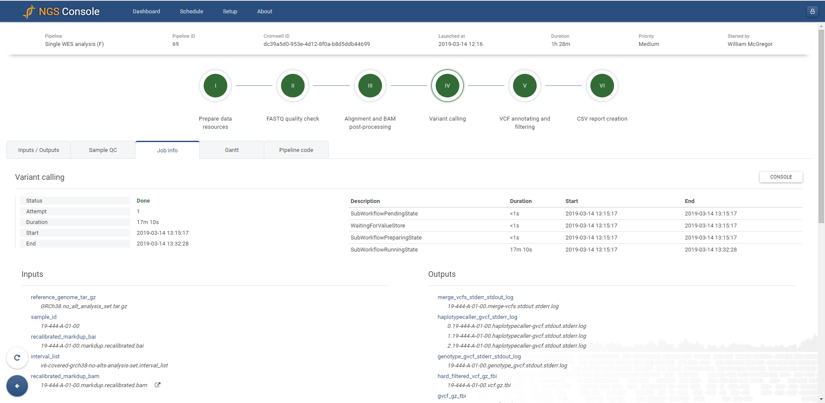
NGS Console – Variant Calling

Slide 21
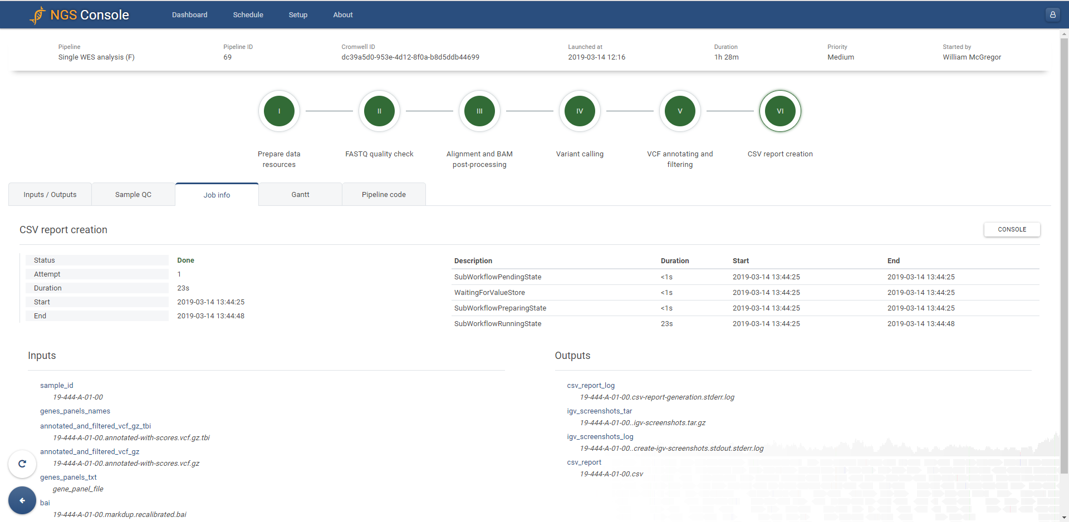
NGS Console – CSV Report Creation
After processing of NGS pipelines, variants are automatically downloaded to SoftGenomics Tasklist and available for reporting

Slide 22
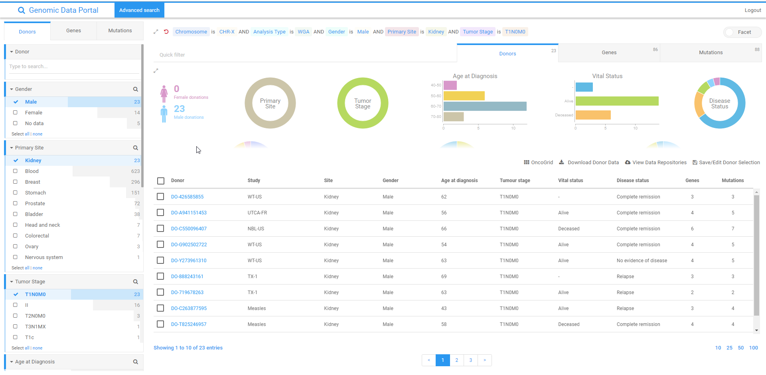
Genomic Data Portal
Genomics Data Portal is optional module to use with SoftGenomics to view genomics results by various criteria like Mutation, Gender, Patient Age, Body Site, Tumor Stage

Slide 23
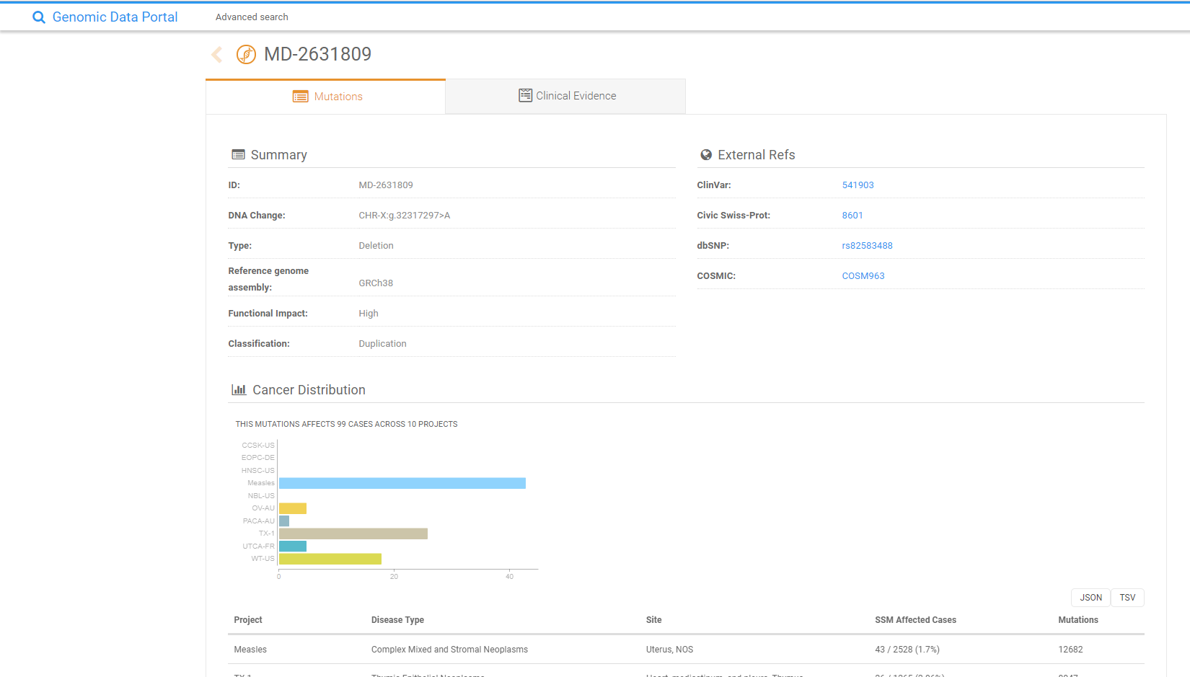
Genomic Data Portal - Mutations
Mutations are summarized and additional Clinical Evidence and External References can be viewed

Slide 24
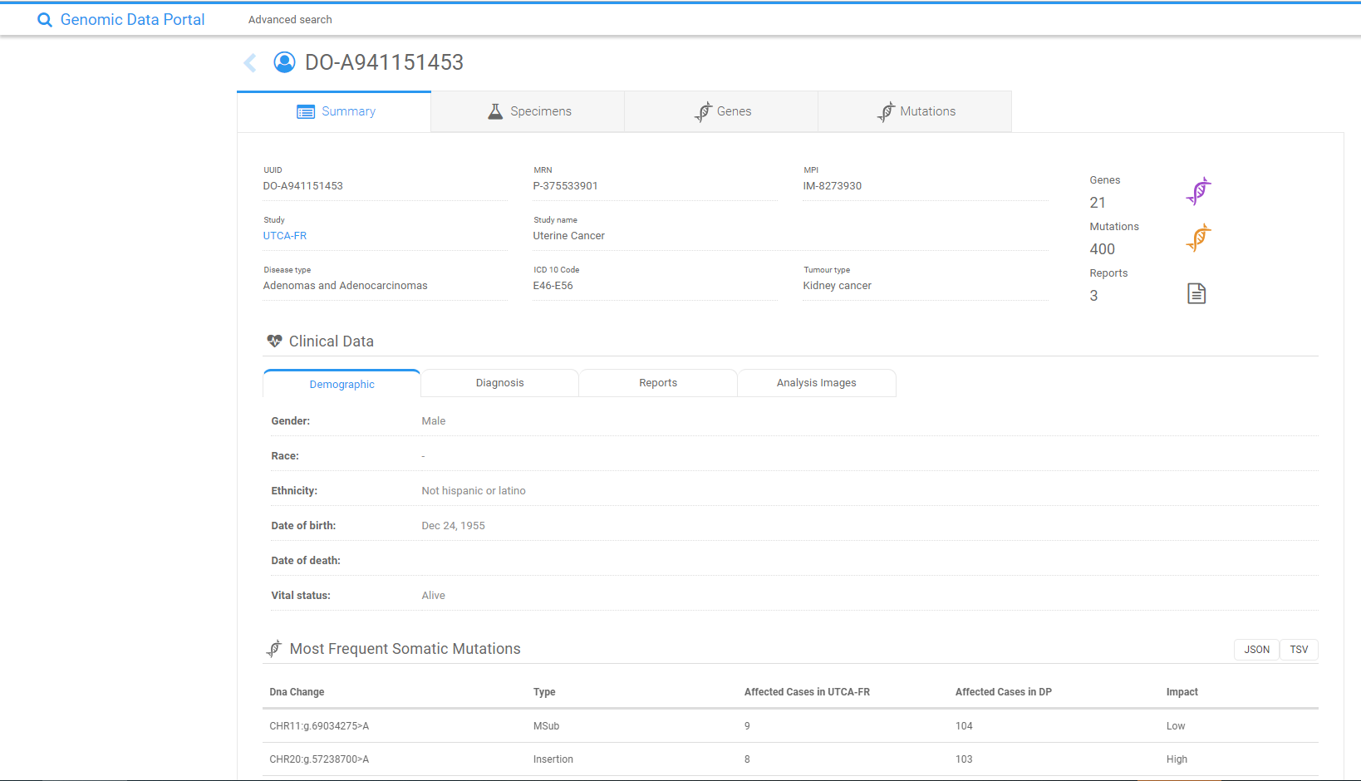
Genomic Data Portal – Summary
Full summary gives an overview of associated clinical data, genes, and mutations involved.

Slide 25
Where we are going – The Future
Prior to release of the SoftGenomics truly merged module, clients can still purchase SoftMolecular and SoftCytogenetics separately based on their needs. Each of the modules could be implemented with or without SoftGenePortal.
After completion and release of the SoftGenomics merged module, any new or upgrading client will be on a line with SoftGenomics. The previous lines that have these modules separate will continue to be supported.

Slide 26

Thank you!
“The best way to predict your future is to create it.”
― Abraham Lincoln

Slide 27

Please remember to take a few moments to fill out the session survey. You can find the QR code in your Conference Brochure as well as hyperlinks to the survey online at www.snuginconline.org with the SNUG 2019 handouts.

