Slide 1
The Future of SoftBank
Presented by:
Jacek Pawelec-Blood Services Architect
Laurie Sapp-Blood Services Product Analyst

Slide 2
The Future of SoftBank
This session will provide high level clearance to our SoftBank Secret Agents to explore restricted files containing Prototypes, Future plans and New Features

Slide 3
SoftBank-Secret Agent Credentials

Slide 4
Secret Agent Credentials
SoftBank Secret Agent Credentials access
Case File-Web User Interface Prototype
Case File-Future Plans
Case File-New Features

Slide 5
Case File-Web User Interface Prototype

Slide 6
Case File-Web user Interface Contents
New web user interface will allow access to SoftBank and SoftDonor using a standard web browser.
Web user interface provides a new look for SoftBank and SoftDonor.
Web Browsers such as:

Slide 7
Web User Interface Prototype Demonstration

Slide 8
Case File-Future Plans

Slide 9
Case File-Future Plans Contents
Interface changes-Epic BPAM
Ability to transfer units using the invoice number
Test Verify Enhancements
Collection Module
Ability to allow automatic verification of results coming an instrument
Automatically added comments

Slide 10
Interface Changes-Epic BPAM
External transfusion system will be enhanced to have the ability to receive transfusion status updates from Epic BPAM.
This functionality requires newer Epic BPAM software.
This functionality will be available in higher lines of SoftBank

Slide 11
Interface Changes-Epic BPAM
The following information can be received:
Transfusion start date/time
Starting transfusion user ID
Second starting transfusion user ID
Transfusion stop date/time
Stopping transfusion user ID
Volume transfused

Slide 12
Interface Changes-Epic BPAM
Benefits:
Presumed transfused will no longer be needed (actual transfusion date/time) for units that are transfused using Epic BPAM
The transfusion information will be stored by SoftBank

Slide 13
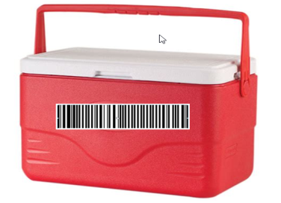
Transfer using invoice number
Proposal:
SoftBank will be able to register delivery of units transferred between sites using invoice#
The functionality for initiating transfer will not change.
User will select units to be transferred and specify destination site code and invoice#
The receiving site will display list of invoices that contain units destined for this facility.
Once the invoice is selected the list of units from that invoice with check box will be displayed
The check box will be checked by default indicating that unit will be accepted

Slide 14
Test Verify-Proposed Enhancements
Additional Selection Criteria
Ability to Edit Results
Refreshing the verify list

Slide 15
Test Verify-Additional Selection Criteria
Additional selection criteria:
Test Code - basic test code
Order # - Order number, HIS order number, Dynamic order number (foreign barcode) and Auxiliary order number

Slide 16
Test Verify-Ability to Edit Results
Adding the ability to edit results in the Test Verify options.
Users with appropriate security access will be able to edit test results (F9-Results).
The system will generate an exception as defined in the parameter hos_spr_TVEdit when a test result is changed.

Slide 17
Test Verify-Edit Results

Slide 18
Test Verify-Edit Results Exception

Slide 19
Test Verify-Refresh List
The Results>Test Verify options now provide the ability for the list of tests in a "To Verify" status to be updated by removing recently verified tests from the list as well as adding new tests in a "To Verify" status to the list.

Slide 20
Collection Module
The system will display the Collection Module field and up to 30 characters value (read-only) in the Order Entry window based on the setting of hos_ColModule. 
Collection Module value in SoftBank can be overwritten when it is updated in SoftLab, based on the setting of bbSpecDataOver.

Slide 21
Collection Module field in Order Entry window

Slide 22
Automatic Verification of Instrument Results-Proposed Changes
Allow instrument results to be automatically verified (set to completed status) based on specific criteria.
Automatic Verification functionality would be introduced by the setting of a new parameter (hos_AutoVerify).

Slide 23
Automatic Verification-Controls
Indicate the phase results that would require verification (Setup>Tests>Phases).
Require abnormal results to be verified (Setup>Tests>Group>Interpretation table)
Determine elements in the Patient Caution Window that would require results to be verified (new parameter (hos_AutoVerPatHis)
Any result that would generate an exception or warning would not qualify for automatic verification.

Slide 24
Automatic Verification Controls Phase Results
Setup>Tests>Phases “Ver” checkbox added
The checked phases require verification
Instrument results that contain a test with a phase result that requires verification will not qualify for automatic verification

Slide 25
Automatic Verification Controls Abnormal results
Interpretations marked as “Abnormal” will not qualify for automatic verification. (Setup>Tests>Group>Interpretation table)

Slide 26
Automatic Verification Controls Patient Caution Window Elements
New parameter hos_AutoVerPatHis-to determine the elements in the Patient Caution Window that if present would prevent instrument results from qualifying for automatic verification.
Patient Caution Window elements:
“B” patient has antibodies on record.
“G” patient has antigens on record.
“M” patient has special messages on record.
“T” patient has transfusions on record.
“R” patient has transfusion reactions on record.
“D” patient has ABO/Rh difficulties on record.
“H” patient has HLA type on record.
“V” patient has a BSA link on record.
“S” patient has a positive antibody screen on record.
“A” patient has Autologous, Directed, or Held units on record.
“L” patient has linked patient, MPI similar patient on record.
“E” patient has data events on record.
Example setting hos_AutoVerPatHis “BMDS”

Slide 27
Automatic Verification Controls Exceptions and Warnings
Any result that would generate an exception or warning would not qualify for automatic verification.
These controls are part of the programming for this feature, not setup driven
Examples: Illogical interpretation, Previous result different, Specimen expired

Slide 28
Automatic Verification Verified instrument results

Slide 29
Automatic Verification Results that require verification

Slide 30
Automatic Comments
Canned Messages can be defined to be used in RBS rules to automatically add comments to results.
The RBS rules are associated with a test in Setup>Tests>Group

Slide 31
Automatic Comments Canned Message Setup

Slide 32
Automatic Comments Test Setup-New Function Key

Slide 33
Automatic Comments Test Setup-Code for canned message

Slide 34
Automatic Comments Test Setup-When the comment will be added

Slide 35
Automatic Comments Test Setup-Comment Placement

Slide 36
Automatic Comments Test Setup-Test/Result record

Slide 37
Automatic Comments Test Setup-RBS comment rule complete

Slide 38
Automatic Comments Patient Order

Slide 39
Automatic Comments Patient Order with results

Slide 40
Automatic Comments Results with comment

Slide 41
Case File-New Features

Slide 42
Case File-New Features Contents
SoftBank Version 25.5.5
Expanded unit number field
Special Testing barcode
Reflex testing
Exception when specimen outdate is changed
Caution window function key(SIG request)
SoftMedia Bridge for Order-related documents
Electronic crossmatch with clinically insignificant antibody

Slide 43
Unit Number field-expanded to allow up to 24 characters

Slide 44
Special Testing Barcode
Special Testing Barcode is an optional product barcode in the ICCBBA U.S. Consensus 3.0.
ISBT Data Structure 012 provides information regarding red blood cell phenotypes, CMV antibody, IgA, Parvovirus B19, Hemoglobin S. (ISBT 128 Standard Technical Specification v5.9.0 )
The Special Testing Barcode can be scanned at product delivery.
The Special Test Barcode will be printed on a modified product label.

Slide 45
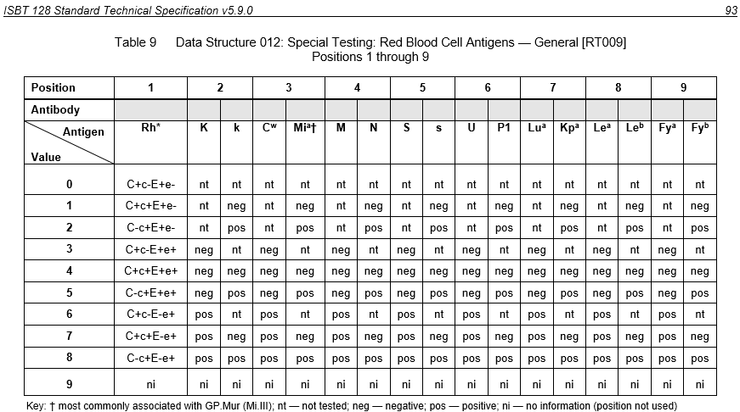
Data Structure 012: Special Testing: Red Blood Cell Antigens

Slide 46
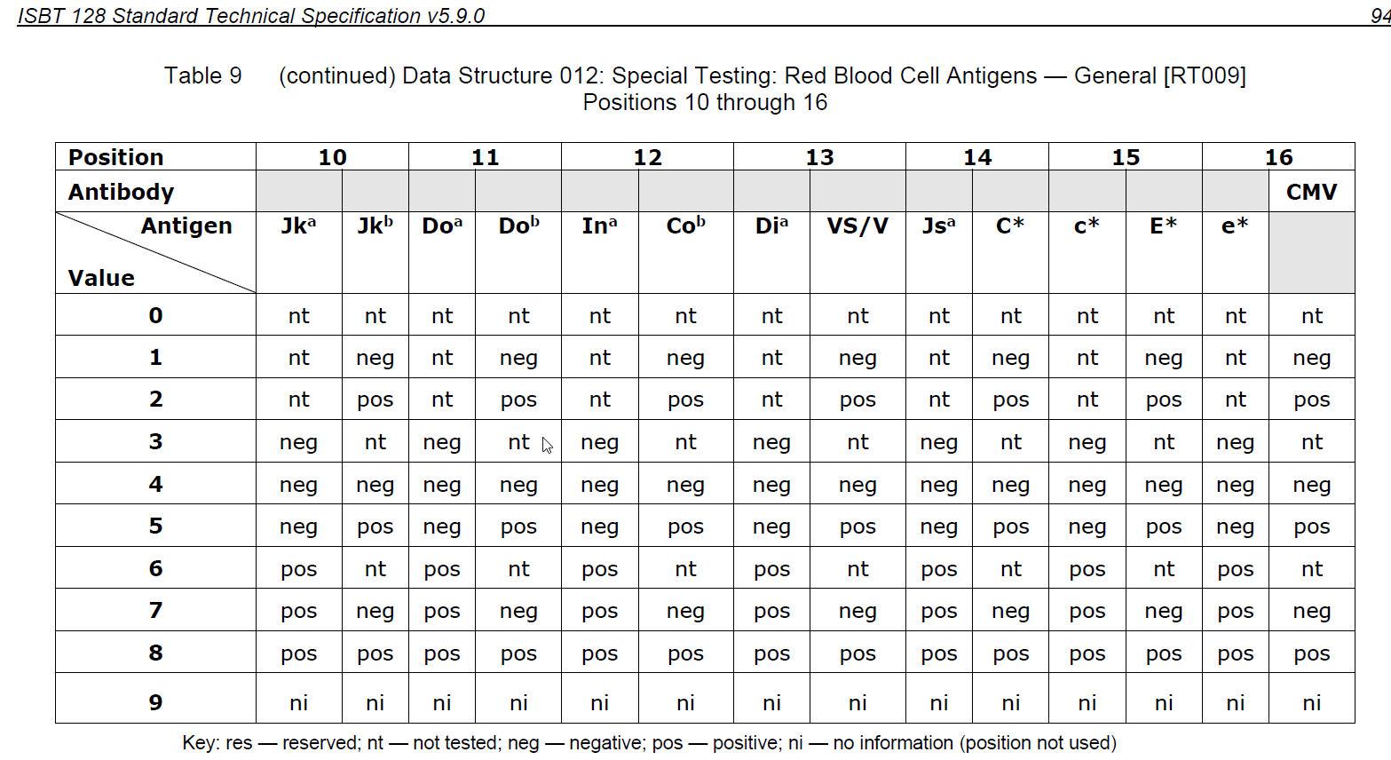
Data Structure 012: Special Testing: Red Blood Cell Antigens

Slide 47
Special Testing Barcode-Antigen Setup
In Setup>Blood>Antigens the Common Ag field has been added to match client specific antigen setup to the antigens in the ISBT Data Structure-012 of Special Testing Red Blood Cell Antigens tables

Slide 48
Special Testing Barcode-Attribute Setup
In Setup>Blood>Attribute the Common Attribute field has been added to match client specific attribute setup to the attributes in the ISBT Data Structure-012 of Special Testing Red Blood Cell Antigens tables.
The Print field/checkbox has been added to provide the ability to print an attribute that is not included in the special testing barcode on a separate label.

Slide 49
Special Testing Barcode-In/Out>Delivery

Slide 50
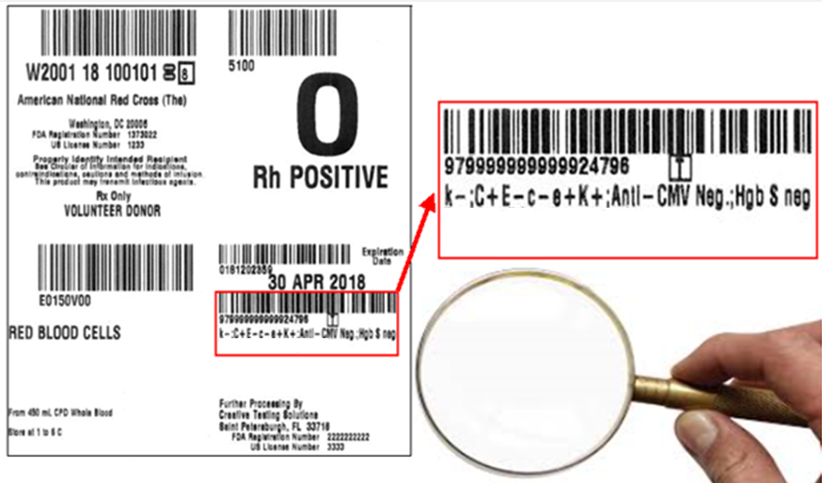
Special Testing Barcode Sample Label

Slide 51
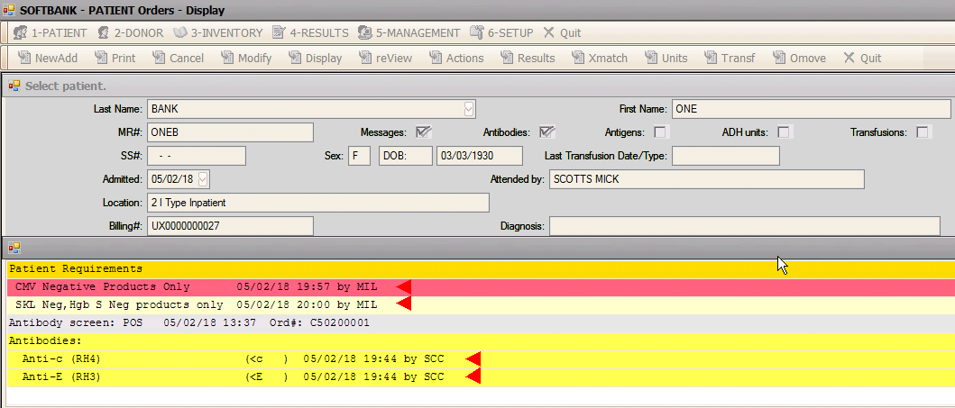
Special Testing Barcode Patient with special requirements

Slide 52
Special Testing Barcode Unit with special testing

Slide 53
Special Testing Barcode Unit displays in the list of available units for the patient

Slide 54
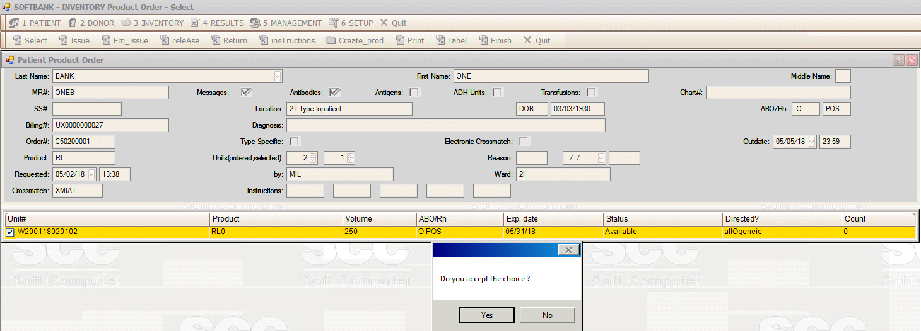
Special Testing Barcode Product Select

Slide 55
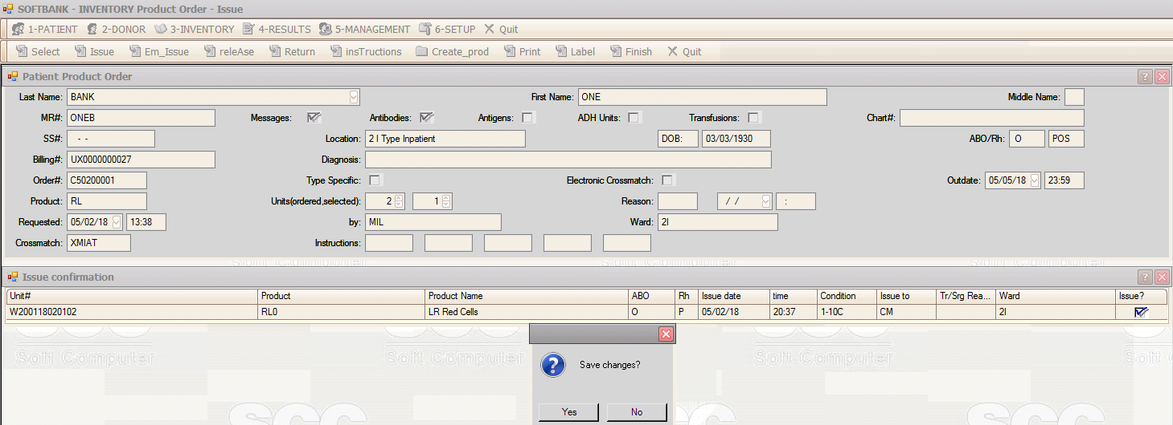
Special Testing Barcode Product Issue

Slide 56
Reflex Tests
This is a setup driven feature.
The system can be setup to add a confirmatory Blood Type test to the existing order when a patient does not have a previous type on record.
The system can be setup to add an additional test based on a positive result.

Slide 57
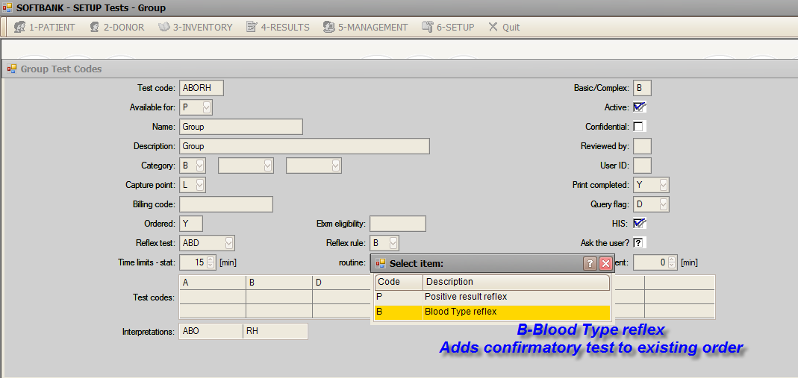
Reflex Tests Test Setup-Blood Type Reflex

Slide 58
Reflex Tests-Confirmatory Type added to current order

Slide 59
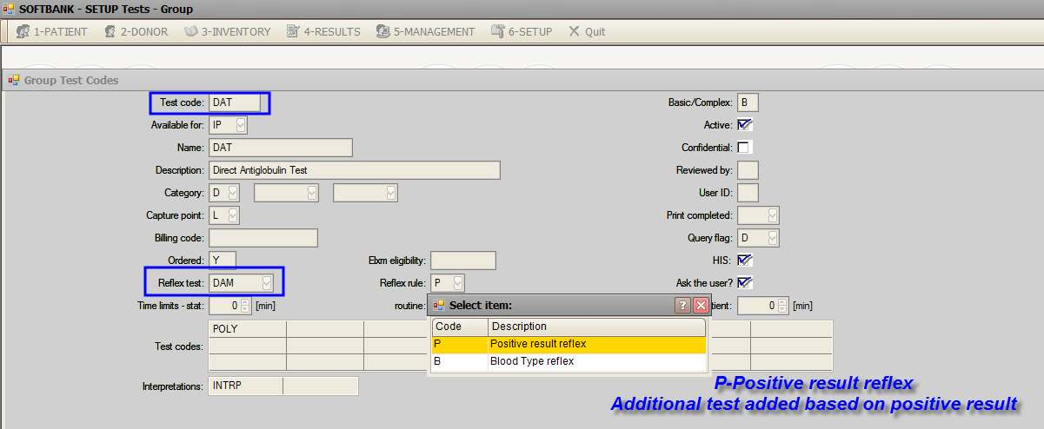
Reflex Tests Test Setup-Positive Result

Slide 60
Reflex Tests-Patient Order

Slide 61
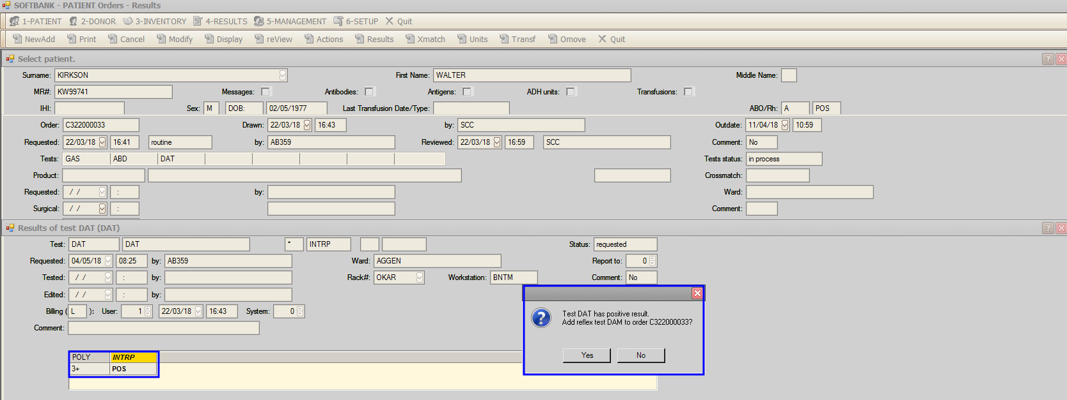
Reflex Tests-Positive Result

Slide 62
Reflex Tests-Additional test added

Slide 63
Specimen Outdate Exception
The system can generate an exception for supervisor review when the patient specimen outdate is changed based on the setting of hos_EditSpecOutdate "<Flag>,<Exception>"

Slide 64
New Function Key-Patient Caution Window
Patient>Orders>Cancel, Modify, Display, Review, Actions, Results, Xmatch, Units, Transfusion.
Patient>Transfusions>Confirm, View, Edit, workup, reaction
Patient>Edit>Comments, Messages, Antibodies, Antigens, HLA, Demographics, Hold.
Patient>Display>Order, Transfusion, Comment, Message, Antibody, Antigen, HLA, Demographics, Units_Autologous/Directed, History.
Link, Merge, Stay_Merge, Stay_move.
Product Order Service>Patient>Maintenance>Discharge
Select, Issue, Em_Issue, Release, Return, Instructions, Create_prod (Change, Divide, Pool, pool_edit), Label.
Results>Joint, Patient Test, and Crossmatch worksheets

Slide 65
New Function Key-Display Patient Caution Window
Access Ctrl+W-Patient Caution Window to display the caution when needed.

Slide 66
SoftMedia Bridge to Order-related documents
Specimen collection declaration signed by the person collecting the specimen is stored in SoftMedia
Specimen collection declaration is viewable in SoftBank options where order information can be viewed.
Select Ctrl+G function key to display and modify (based on security) order-related documents using SoftMedia attributes MRN and ORDER.

Slide 67
Sample Collection Declaration

Slide 68
Electronic Crossmatch with clinically insignificant antibody
This enhancement will allow a RC product to be issued to a patient with a positive antibody screen with no clinically significant antibodies identified.
hos_CheckSignifAntib - checks for clinically significant antibodies

Slide 69
Electronic Crossmatch with clinically insignificant antibody
Electronic crossmatch eligibility is met by the following criteria:
1. Patient ABO has been performed twice and consecutively matches in the system.
2. Patient has completed ABORh tests on current specimen.
3. ABO, Rh (or ABORh) test interpretations on current order and linked order, when one exists, matches patient ABO/Rh record.
4. Patient has a Negative antibody screen on a current specimen OR
5. Patient has a Positive antibody screen on a current specimen and there is at least one completed antibody ID with no pending antibody IDs on current specimen.
6. Patient has no clinically significant antibodies registered.
7. Specimen for current order and linked order, when one exists, are not outdated.

Slide 70
Electronic Crossmatch with clinically insignificant antibody Antibody Setup

Slide 71
Electronic Crossmatch with clinically insignificant antibody Unit Selection-ABID not completed

Slide 72
Electronic Crossmatch with clinically insignificant antibody Unit Selection-Caution Window

Slide 73
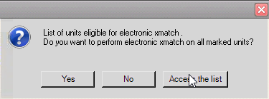
Electronic Crossmatch with clinically insignificant antibody Unit Selection-ELXM allowed

Slide 74
SoftBank-Secret Agent Credentials EXPIRED

